Slide 1
Computer Organisation 1
Display devices
Sébastien Piccand
sebastien.piccand@ul.ie

Slide 2
Display devices
Main characteristics
Monitors
Touchscreens
Tablet PC
Interactive whiteboards
Projectors
E-Readers

Slide 3
Display devices
Main characteristics
  Size <> viewable area: CRT vs LCD
  Viewing angles
    Vertical and horizonta
  Aspect ratio: 4:3, 16:9l
  Resolution
    Number of pixels per line/column
  Dot pitch
    Space between pixels

Slide 4
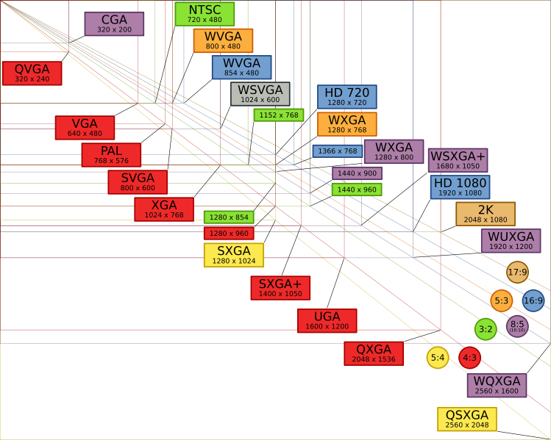
Display devices
Resolution standard
Note HD vs PAL/NTSC

Slide 5
Display devices
Main characteristics
  Response time
    Time to change pixel's color
    Linked to image persistence
  Refresh rate
    Number of times per second in which the monitor draws the data

Slide 6
Display devices
Main characteristics
  Color depth
    Number of colors
    Wikipedia: List_of_color_palettes
  Brightness
    Maximum intensity (brightest point)
  Contrast ratio
    Ratio brightest/darkest

Slide 7
Display devices
Main characteristics
Monitors
Touchscreens
Tablet PC
Interactive whiteboards
Projectors
E-Readers

Slide 8
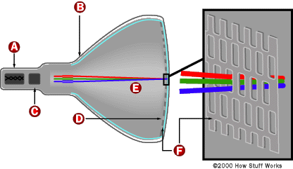

Monitors: CRT
CRT: Cathode Ray Tube

Slide 9
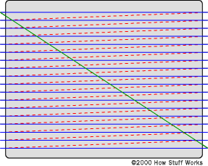
Monitors: CRT
Raster scanning
  Interlacing: even lines/odd lines (TV)
  Progressive scanning (Computers)

Slide 10
Monitors: CRT
High image quality (contrast, brightness, number of colors, viewing angle)
Fast response time
Big device size
Limited screen size

Slide 11
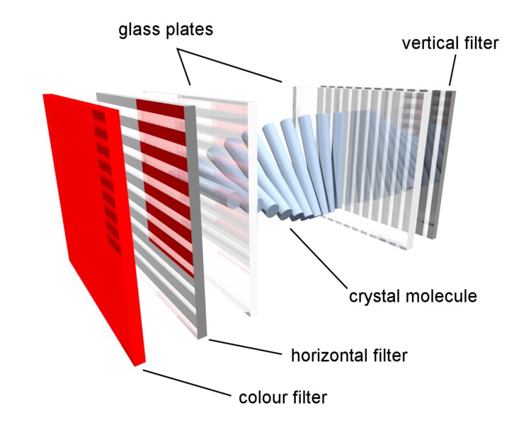
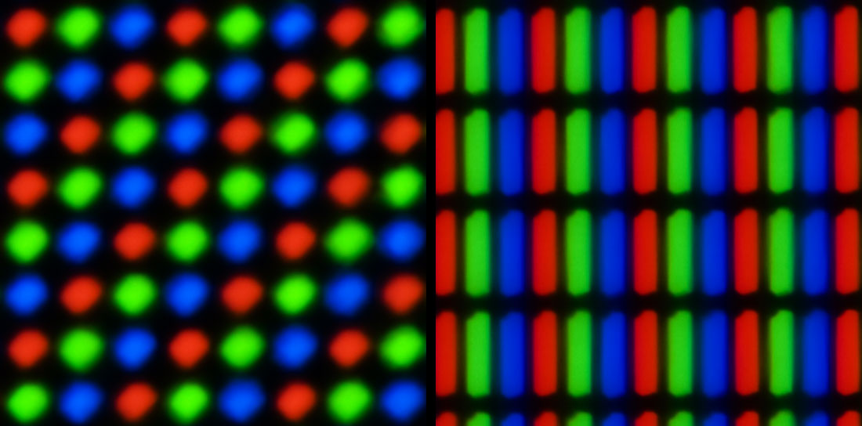
Monitors: LCD
LCD: Liquid Crystal Display
Pixels: made of colored subpixels

Slide 12
Monitors: LCD
Different liquids
  TN: Twisted Nematic
    Short angle, fast response time
  IPS: In-Plane Switching
    Wide angle, slow response time, high contrast, higher consumption
  VA: Vertical Alignement
    Wide angle, med response time, high contrast

Slide 13
Monitors: Plasma
Plasma: gas made up of free-flowing ions (electrically charged atoms) and electrons (negatively charged particles)
High brightness, and contrast
Wide viewing angle
Pb: heavy burn-in

Slide 14
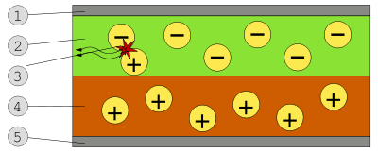
Monitors: OLED
OLED: Organic Light Emitting Diod
High brightness, and contrast
Wide viewing angle
Schematic of a 2-layer OLED: 1. Cathode (−), 2. Emissive Layer, 3. Emission of radiation, 4. Conductive Layer, 5. Anode (+)

Slide 15
Monitors
Future
  Combining benefits of CRT and LCD: multiple tiny CRT
  Surface-conduction electron-emitter displays (SEDs)
  Field emission displays (FEDs)
  Nano-emissive display (NEDs)

Slide 16
Display devices
Main characteristics
Monitors
Touchscreens
Tablet PC
Interactive whiteboards
Projectors
E-Readers

Slide 17
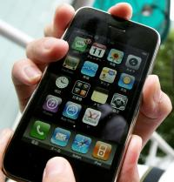
Touchscreens
How do you know when the screen is touched?
Different technologies

Slide 18
Touchscreens
Resistive
  Two layers put in contact
Capacitive
  Electric current on the surface
Surface acoustic gauge
  Ultrasonic waves
Strain gauge
  Screen on springs

Slide 19
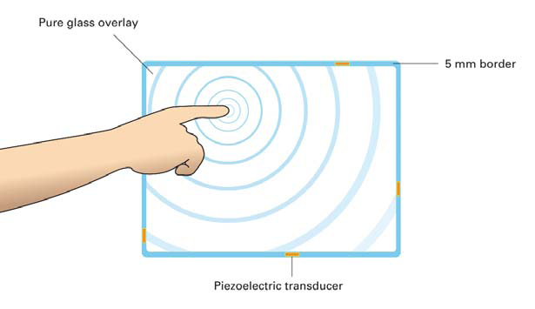
Touchscreens
Optical imaging
  Image sensors in the corner
Dispersive signal technology
  Sensors to detect mechanical energy
Acoustic pulse recognition

Slide 20
Display devices
Main characteristics
Monitors
Touchscreens
Tablet PC
Interactive whiteboards
Projectors
E-Readers

Slide 21
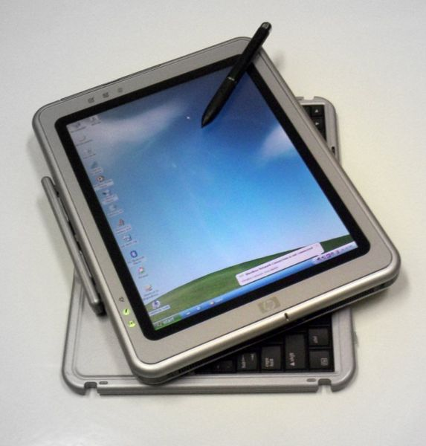
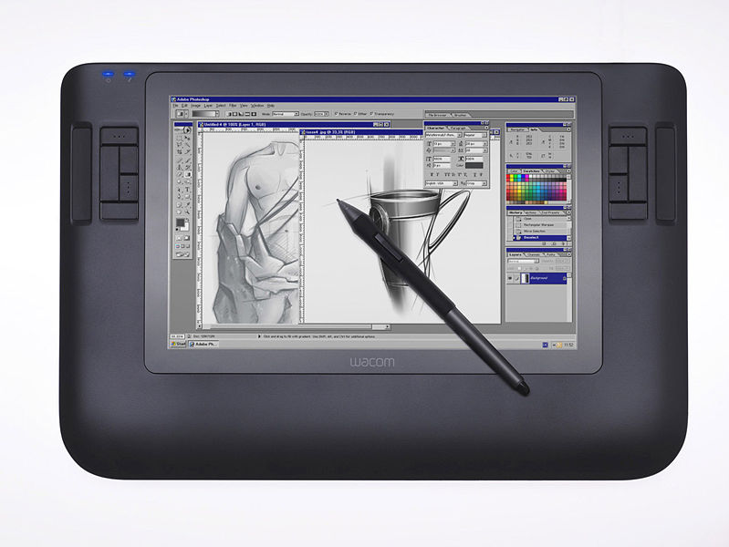
Tablet PC

Slide 22
Tablet PC
Technology
  Touchscreen
  Graphics tablet/screen hybrid
    Higher resolution
    Often more possibilities (measure of pressure...)
With or without keyboard
Useful to take notes

Slide 23
Display devices
Main characteristics
Monitors
Touchscreens
Tablet PC
Interactive whiteboards
Projectors
E-Readers

Slide 24
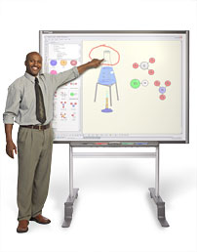
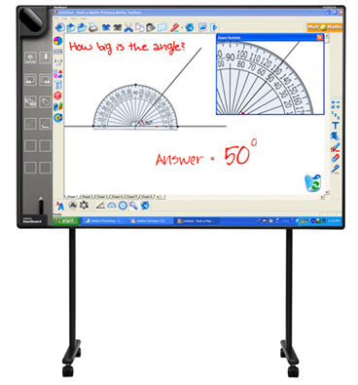
Interactive whiteboards

Slide 25
Interactive whiteboards
Like a giant touchscreen with dedicated software
Possible to connect Tablets for sharing
Front or rear projection
Youtube demo

Slide 26
Display devices
Main characteristics
Monitors
Touchscreens
Tablet PC
Interactive whiteboards
Projectors
E-Readers

Slide 27
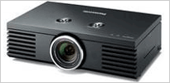
Projector
Home cinema
Presentation (this lecture!)

Slide 28
Projector
CRT projector
  3 big projectors (Red, Green, Blue)
  High quality
  Hard to set properly
  Huge
LCD projector
  LCD panel crossed by lights
  Contrast and brightness not as good
  Can see pixels

Slide 29
Projector
DLP projector
  Using Digital Micromirror Device (DMD)
    Many tiny mirrors; Two positions: on/off
  Smooth image, rather low contrast
LCOS projector
  Liquid crystal on silicon
    Mirrors + reflective dye
  Higher resolution

Slide 30
Display devices
Main characteristics
Monitors
Touchscreens
Tablet PC
Interactive whiteboards
Projectors
E-Readers

Slide 31
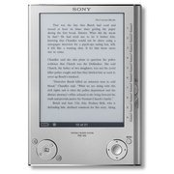
E-Reader (E-book readers)

Slide 32
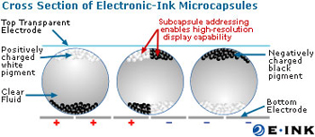
E-Reader
LCD
  LCD monitor or touchscreen
Electronic ink
  Millions of tiny microcapsules
  E-Ink and Xerox: main manufacturers

Slide 33
E-Reader
Advantages of electronic ink over LCD
  Low power usage: turn on only when changing page
  Flexibility: can bend when combined with plastic transistors
  Readability (no pb in the sun)
e.g.: Plastic Logic

